Slide 1
SEED STRUCTURE AND FUNCTION

Slide 2
SEEDS
The most dramatic innovation which occurred during the evolution of vascular plants is the seed.
The seed undoubtedly is one of the reasons responsible for the dominance of the seed plants in today’s flora

Slide 3
Flowering plants have been extremely successful and useful to man as a source of food, clothing, shelter, furniture, fuel, etc.

Slide 4
Flowering plants owe their widespread distribution to various adaptations
These include:
The production of pollen
Production of flowers
Ability to retain moisture, transportation of water and other resources between plant parts, upright growth, etc

Slide 5
  The capacity to produce seeds makes the seed plant, particularly the angiosperms, dominant over spore bearing plants
  The seed has a high survival value and therefore has a greater chance of surviving and producing new generation than the spores do.

Slide 6
The success of the flowering plant is in great measure due to the effectiveness of the seed as a perennating and dispersal organ.
The seed has an indispensable means of survival and spread.
It is the end product of a complex series of processes.

Slide 7
The seed is a complex package containing a dormant embryo (the living germ) and its food supply, both wrapped in a complex seed coat (testa) formed from the integument.

Slide 8
The seed is not only a means of multiplying a species, and of protecting a living germ against unfavourable conditions,
it contains the result of a rearrangement of genetic material which has been brought about by the complementary events of meiosis and fertilization.
.

Slide 9
The testa is generally dry
but some have fleshy appendages such as the elaiosomes with fleshy structures attached
or juicy covering such as the edible outer epidermis of some seed coats as in pomegranate

Slide 10
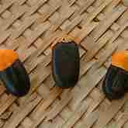

Slide 11
The protective covering is always of highly specialized tissues.
The cell walls are thickened and heavily impregnated with materials such as suberin and cutin.

Slide 12
It is resistant to decay/chemical agents and some are involved in controlling the germination of the seed.
Phenolic compounds present in the seed coat also influence the germination process.

Slide 13
The seed coat in some species have features that assist dispersal.
Some seed coats are resistant to the digestive processes and permit the seed to pass through the digestive tract without damage.

Slide 14
The food supply is either
stored in the endosperm tissue adjacent to the embryo
or transported to the cotyledon (where they are stored)

Slide 15
Almost all seeds contain some reserved nutrients.
In some cases it may take up 85-90% of the seed’s dry weight.

Slide 16
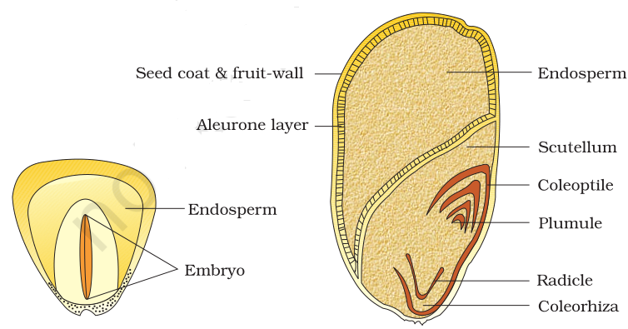

Slide 17
Very small seeds like Lactuca sativa (lettuce) which weigh only a few milligrams can support embryo growth for several days.
But the bean (about 1.5g) can support embryo growth for several weeks.

Slide 18
Coconut seedlings have been found to deplete only half of their food reserves during 15 months of growth in darkness.
Only few seeds have any significant food reserves beyond those stored in the endosperm and the cotyledon.

Slide 19
Occasionally, a perisperm which is a persistent nucellus (central part of ovule in which the embryo sac develops) of the ovule is found.
The perisperm is common in the families Liliaceae and Piperaceae.

Slide 20
Usually only one type of storage tissue is present in any one seed, but this is not universally so.
Eg in the Nutmeg (Myristica fragrans) both perisperm and endosperm are found.

Slide 21
The inner tissues of a resting seed is generally made up of parenchyma, though the embryo has an immature vascular bundle.
The tissues are usually hard due to very low water content.

Slide 22
The embryo in most seeds has a root apex as well as a shoot apex which are protected by coleorhizae and coleoptile respectively.
The embryo has a leaf or two.

Slide 23
Seeds vary immensely in size, shape and structure
and this is largely associated with the mode of dispersal and the conditions they encounter in the natural habitat of the species.

Slide 24
Seeds are important sources of food for animals and man.
Members of the family Poaceae/Graminae provide more food seeds than any other plant family.
This is followed by the family Fabaceae.

Slide 25
Seeds have many other uses other than food:
Beverage
Fibre
Medicine
Industrial oil, etc.

Slide 26
Functions of seed
Serves for reproduction
A vessel or receptacle in which the embryo develops
Protects the embryo from excessive heat, cold, attack by pathogens, insects, rodents, etc.

Slide 27
Stores up food for the embryo/seedling
Enhances dispersal to ensure continuance of the plant species.

Slide 28
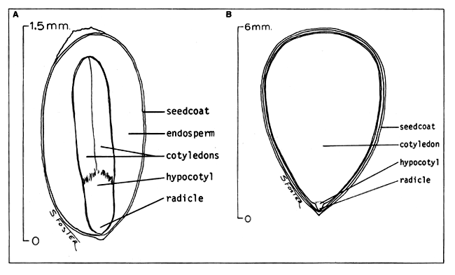
Transverse Section through a seed

